Slide 1
Kelvin Ahiakpor
Web Tech Summer 2024 Final Exams

Slide 2
Kelvin Ahiakpor is developing a data powered website to help IDAFÜ solve streamline health and wellness consultations through an integrated booking and management platform

Slide 3
IDAFÜ
ddd
PROBLEM:Lack of a streamlined system for connecting health/wellness consultants with clients and managing their ongoing consultations efficiently.
PAYOFF: A dashboard showing: Consultation success metricsClient progress trackingConsultant ratings and reviewsBooking statisticsRevenue/session analytics
PERSONA(s) Health-seeking Clients: Individuals looking for wellness guidanceHealth & Wellness Consultants: Qualified experts providing servicesPlatform Administrators: Staff managing the platform operations
FINISH:Clients: Access vetted health experts, book appointments, and track wellness progress all in one secure platform.Consultants: Streamline their practice with integrated booking, client management, and performance analytics tools.Administrators: Gain comprehensive oversight and quality control through real-time metrics and monitoring capabilities.

Slide 4
User / Customer
IDAFÜ is a health and wellness consulting business that provides a digital platform connecting qualified consultants with clients seeking expert guidance. The platform serves as a comprehensive marketplace for wellness services, enabling consultation booking, session management, and progress tracking while maintaining professional standards and secure communication
Roles
Clients who book and receive health/wellness consultations
Consultants who provide expert guidance and manage their services
Administrators who oversee platform operations and maintain quality standards

Slide 5
Main Functions of the Website
3- 4 functions that will be built to solve the problem.
Consultation Booking System with Rating
Analytics And Reporting
User Management System
Monitor platform activity and bookings

Slide 6
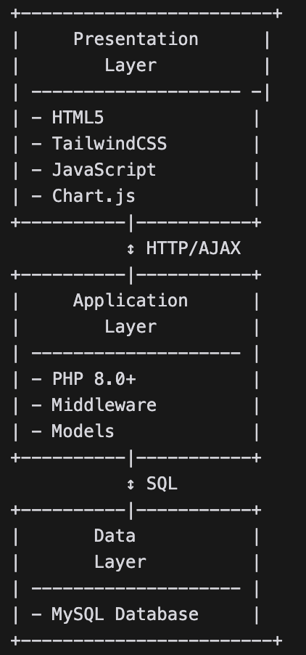
Architecture

